Slide 1


Ledger Management System for Sivasakthi Stores
24PR01
Immanuvel R
Krittika R
Barath Kumar R

Slide 2
Ledger Management System for Sivasakthi Stores
24PR01
Immanuvel R
Krittika R
Barath Kumar R

Slide 3
Company Details
Company Name : Sivasakthi Stores
Location : 1/376-A, Theertham road, Veppanapalli, Krishnagiri, 635121
Contact : +91 9080660749
Core Business : Retail store specializing in Diwali festival goods and chit management
Established
Customer Base : Local community in Veppanapalli region
Email : madhuguna1982@gmail.com

Slide 4
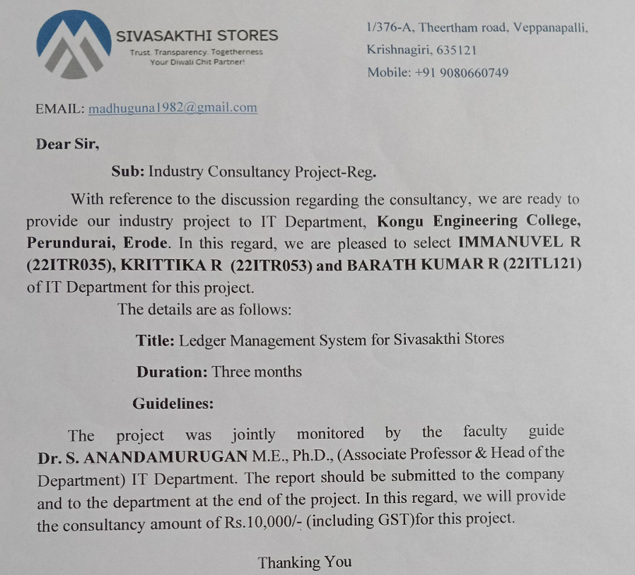
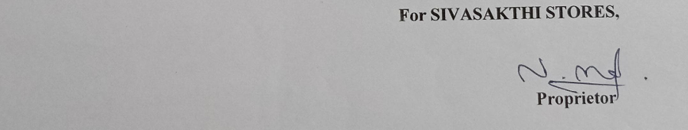
Approval
Letter

Slide 5
Problem Identified
Sivasakthi Stores, a local retail establishment in Veppanapalli, Krishnagiri, has been managing its Diwali chit fund through traditional paper-based methods. This approach has led to several challenges:
1. Inefficient Record Keeping
2. Limited Accessibility
3. Scalability Issues
4. Lack of Real-time Updates
5. Data Security Concerns
6. Reporting Challenges

Slide 6

Requirements Gathered
Customer profile management
Search and filter user data
Database integration
Multiple chit categories
(Gold: ₹500/month, Silver:₹300/month)
Detailed product inventory management
Secure user authentication and admin panel
Payment tracking and history

Slide 7
LedgerGlow

Slide 8

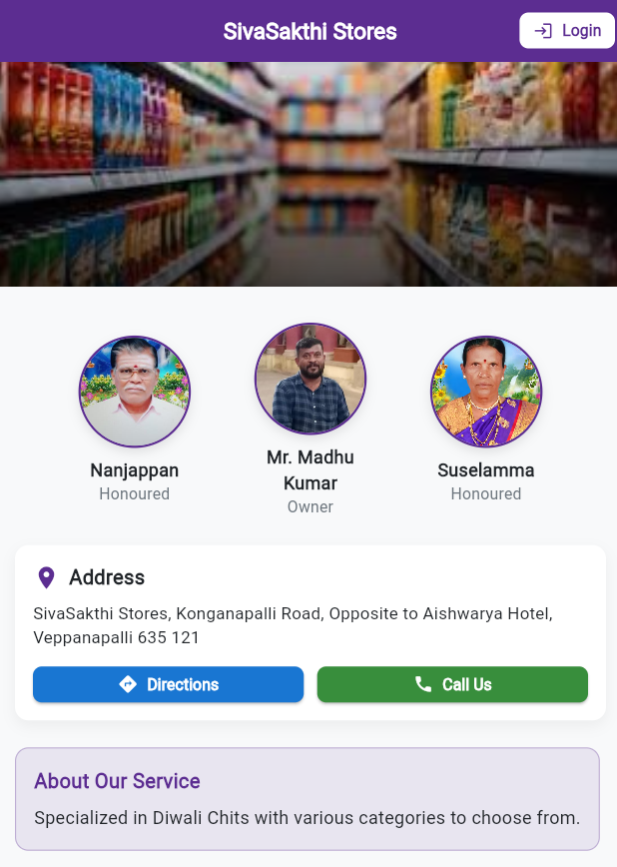

Solution
So based on the problem, we have come up with an App which helps in Chits management

Slide 9



Methodologies
Frontend
Backend
Database
Flutter/Dart
Node.js with Express
MongoDB

Slide 10


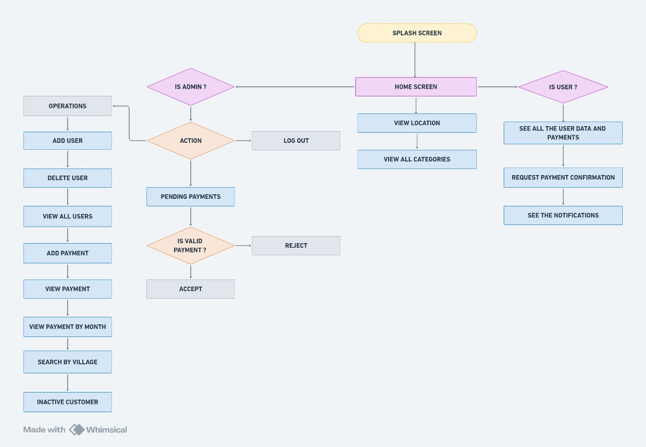
Work Flow
Undo Deleted user

Slide 11
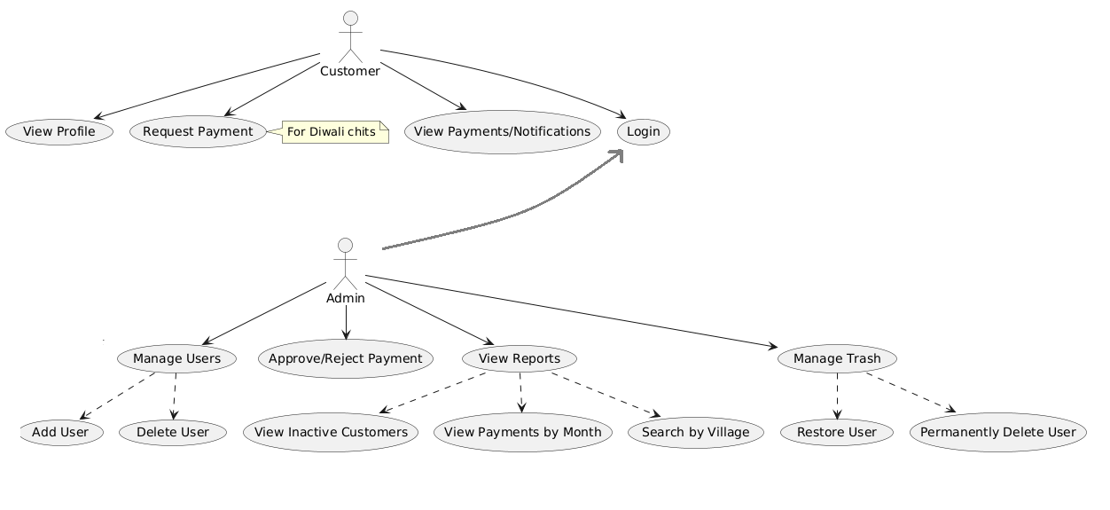
Use case

Slide 12
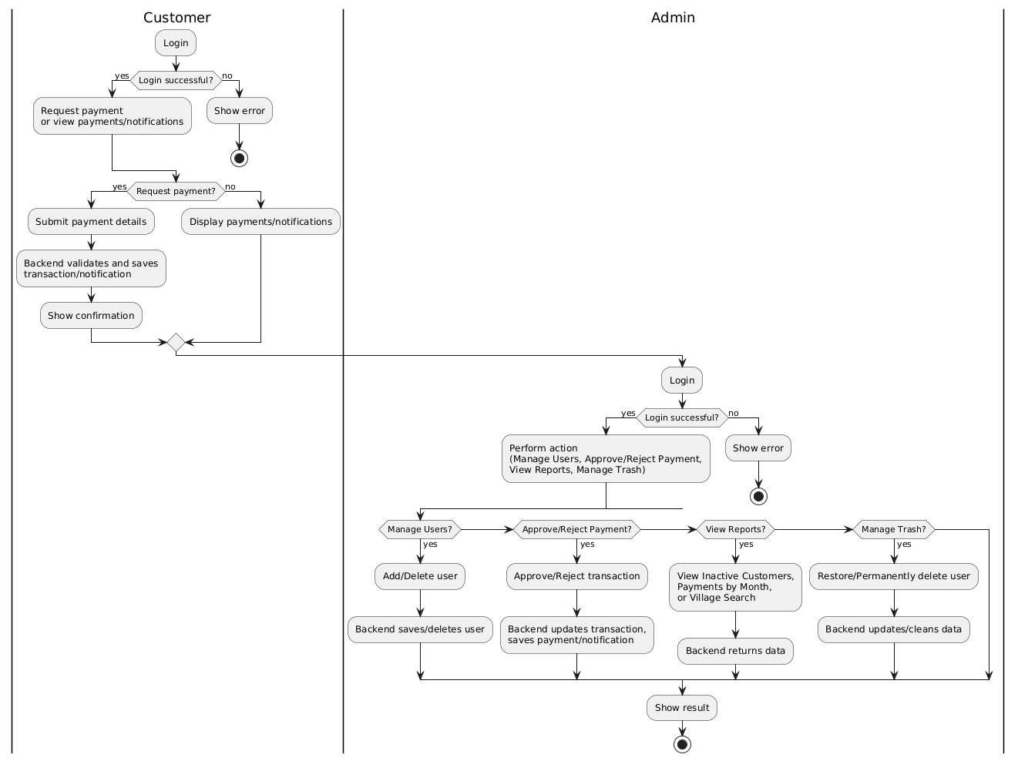
Activity

Slide 13
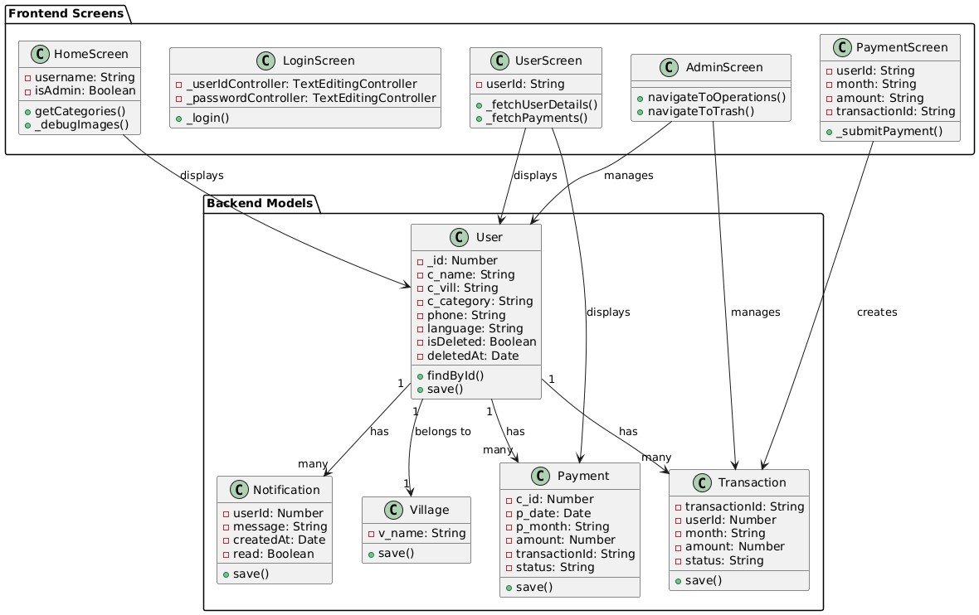
Class

Slide 14
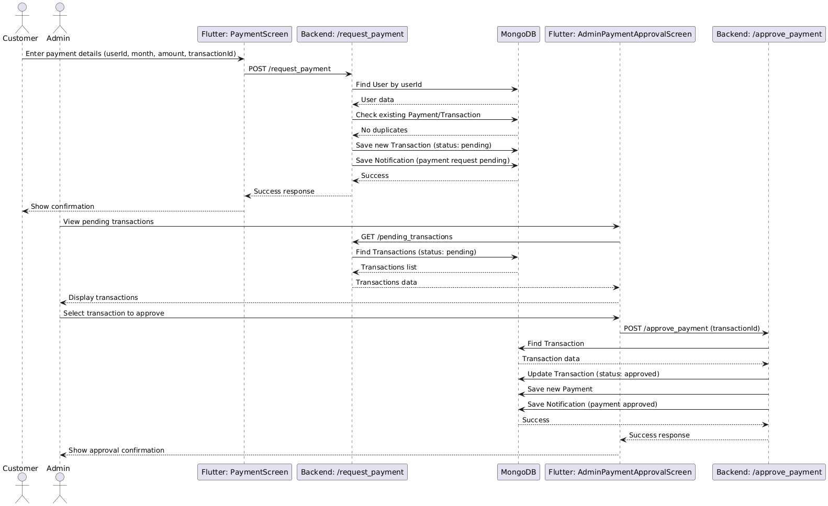
Sequence

Slide 15
Schema
const userSchema = new mongoose.Schema({
_id: Number,
c_name: String,
c_vill: String,
c_category: String,
phone: String,
isDeleted: { type: Boolean, default: false },
deletedAt: { type: Date, default: null },
})
const paymentSchema = new mongoose.Schema({
c_id: Number,
p_date: Date,
p_month: String,
amount: Number,
transactionId: String,
status: { type: String, enum: ["pending", "approved", "rejected"], default: "pending" },
})
const villageSchema = new mongoose.Schema({
v_name: String,
})
const notificationSchema = new mongoose.Schema({ userId: Number,
message: String,
createdAt: { type: Date, default: Date.now },
read: { type: Boolean, default: false },
})
const transactionSchema = new mongoose.Schema({
transactionId: String,
userId: Number,
month: String,
amount: Number,
status: { type: String, enum: ["pending", "approved", "rejected"], default: "pending" },
})

Slide 16
Modules
01
02
03
04
05
Authentication Module
User Management Module
Payment Management Module
Village Management Module
Notification Module
06
Trash Management Module

Slide 17
Objective
01
02
03
04
05
Digitize traditional chit fund management system
Implement secure user authentication system
Streamline customer processes
Provide real-time payment history access
Payment Integration

Slide 18
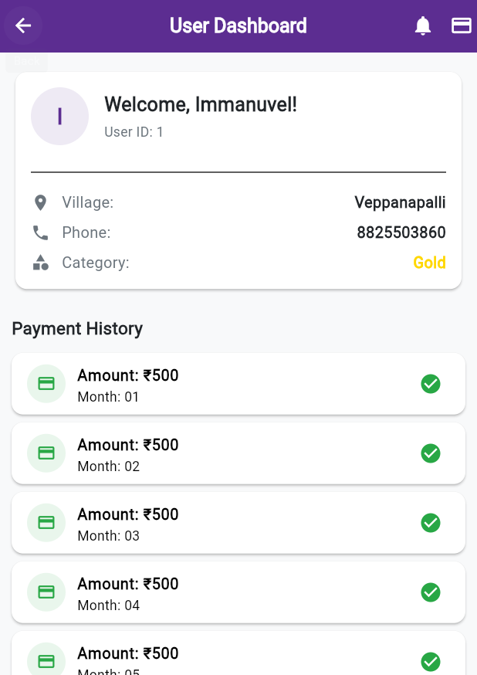
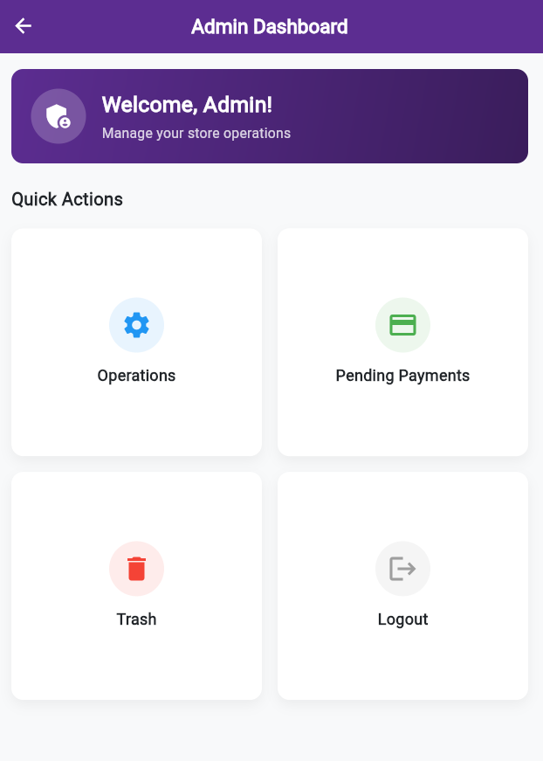
Implementations
02
Implement secure user authentication system
01
Digitize traditional chit fund management system
03
Streamline customer registration and payment tracking
04
Provide real-time payment history access
05
Facilitate easy administration of multiple chit categories
06
Implement notification system for important updates

Slide 19
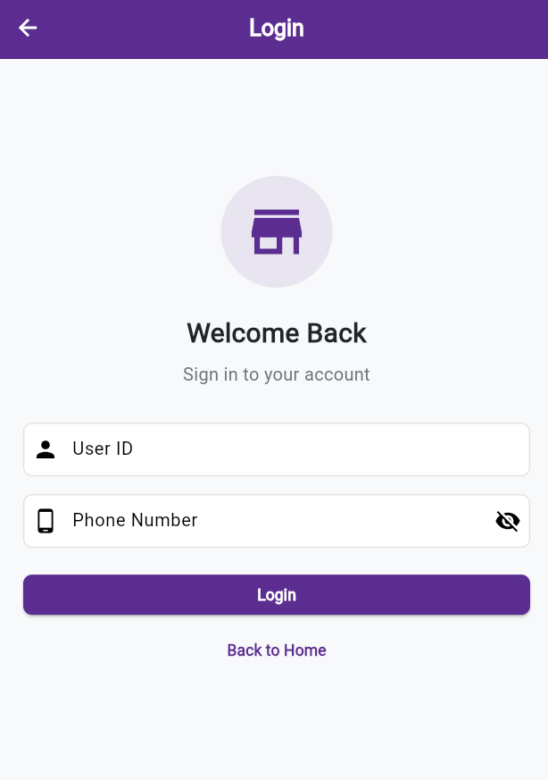
Implementations
02
Implement secure user authentication system
03
Streamline customer registration and payment tracking
04
Provide real-time payment history access
05
Facilitate easy administration of multiple chit categories
06
Implement notification system for important updates

Slide 20
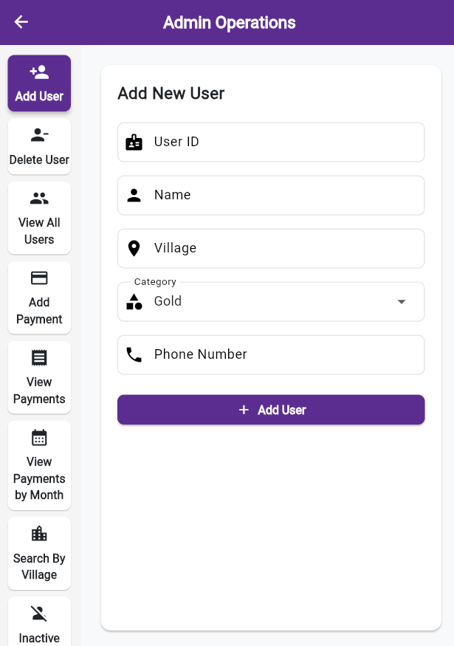
Implementations
Streamline customer processes
03
04
Provide real-time payment history access
05
Facilitate easy administration of multiple chit categories
06
Implement notification system for important updates

Slide 21
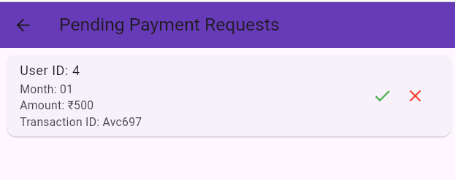
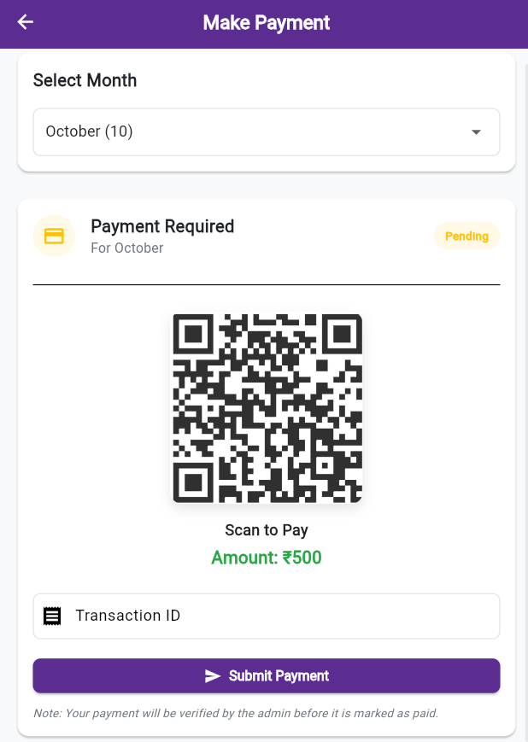
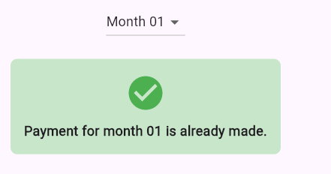
Implementations
04
Provide real-time payment functionality and history access
05
Facilitate easy administration of multiple chit categories
06
Implement notification system for important updates

Slide 22
Implementations
05
Payment Integration

Slide 23
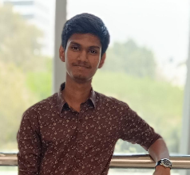

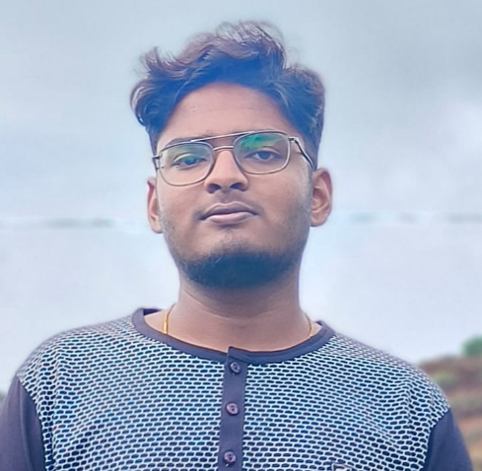
Our principal team
Immanuvel R
Barath Kumar R
Krittika R

Slide 24
Our principal team
Immanuvel R
Krittika R
Barath Kumar R
Requirement collection,
Backend development, Code integration
Schema building, User dashboard
Home page, CRUD operation in mongodb

Slide 25

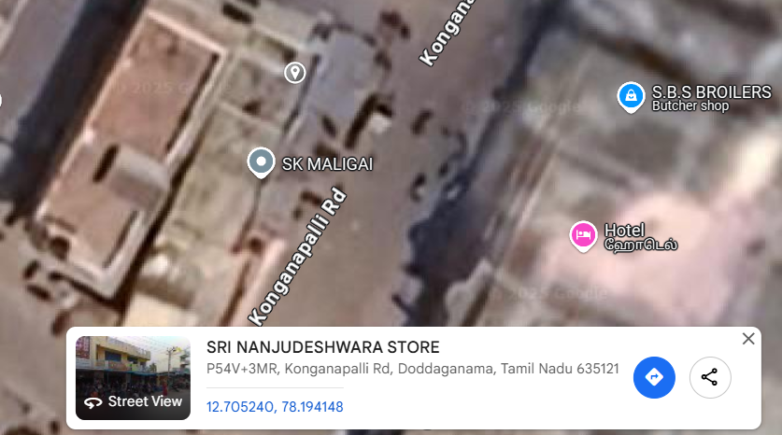
2000 Customers
The target of Mr. Madhu Kumar by 2026

Slide 26
Gold Plating!!
Provide a map to the store

Slide 27

Thank You!

Slide 28
Economy icon pack

